Slide 1
Terraform

Slide 2
Agenda
https://docs.google.com/document/d/1N5hMeCiIOlHp5xd7ipajdAs_uUA0O6Vgo6jNbepvpB8/edit

Slide 3
Timing
Start time at 9.30 am IST
Break - 11.15 am
Lunch - 1 to 2 pm
Break - 3.30 pm
End at 5 pm

Slide 4
Infra setup
AWS account
Ubuntu VM
AWS CLI
VS Code
Terraform CLI

Slide 5
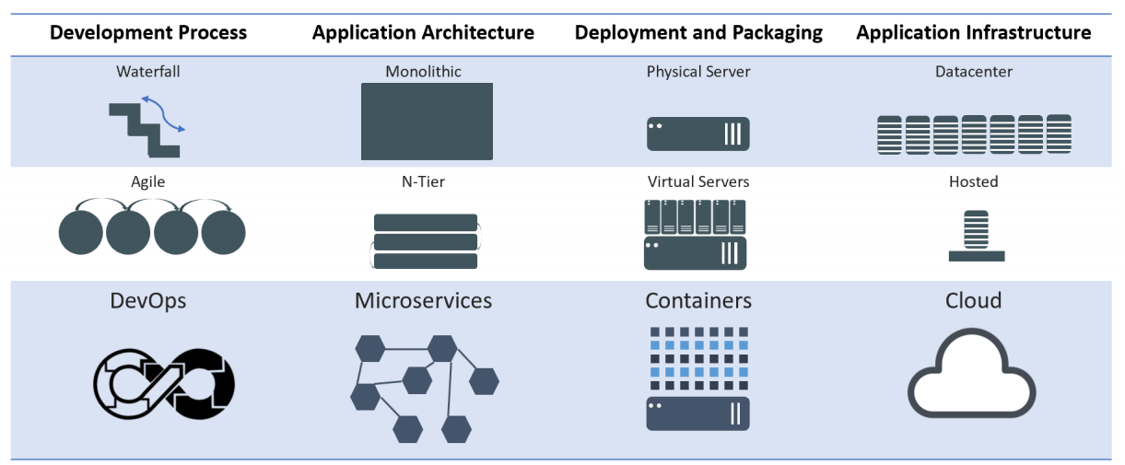
Evolution of Computing
Notes:
Mention WHY the evolution and benefits of adapting to new practices

Slide 6
Infrastructure as code
Infrastructure as Code (IaC) is an approach to managing and provisioning infrastructure in a way that treats infrastructure configurations as code.
This means that you use code, typically in a declarative or imperative language, to define and automate the setup, configuration, and management of your infrastructure, including servers, networking, storage, and other resources

Slide 7
Why Infrastructure as code
Automation: IaC automates the provisioning, configuration, and management of infrastructure, reducing manual, error-prone tasks and ensuring consistency.
Version Control: Infrastructure code can be versioned, allowing for tracking changes, rollbacks, and collaboration among team members using tools like Git.
Scalability: IaC makes it easier to scale infrastructure resources up or down based on demand, adapting to changing workloads.
Reproducibility: With IaC, you can recreate entire environments reliably, ensuring consistency between development, testing, and production.
Documentation: Infrastructure code serves as documentation, making it easier to understand and maintain infrastructure configurations.

Slide 8
Why Infrastructure as code
Collaboration: Teams can work together on infrastructure code, enabling collaboration between developers and operations personnel.
Cost Efficiency: IaC can help optimize resource allocation and reduce wastage by defining infrastructure requirements more precisely.
Security: Security policies and best practices can be codified and enforced in the infrastructure code, enhancing the security of your environment.
Portability: Infrastructure definitions can be used across different cloud providers or on-premises environments, promoting flexibility.
Change Management: IaC provides a structured approach to making changes to infrastructure, ensuring that modifications are planned and tracked.

Slide 9
Terraform
Terraform is an open-source Infrastructure as Code (IaC) tool developed by HashiCorp.
It is designed to help organizations manage and provision infrastructure resources in a declarative and automated way.
Terraform allows you to define, configure, and version your infrastructure using a domain-specific language or HashiCorp Configuration Language (HCL).

Slide 10
Why Terraform
Declarative Syntax: Terraform uses a declarative syntax to define the desired state of your infrastructure. You specify what resources you need, their configurations, and their dependencies, without specifying how to achieve that state.
Providers: Terraform supports a wide range of cloud providers (e.g., AWS, Azure, Google Cloud), as well as other infrastructure components like databases, networking, and more. These providers allow you to interact with various services and resources.
State Management: Terraform maintains a state file that keeps track of the current state of your infrastructure. This state file is used to plan and apply changes while ensuring that the desired state matches the actual state.
Execution Plans: Terraform generates an execution plan before making any changes to your infrastructure. This plan outlines what actions will be taken, such as creating, updating, or destroying resources, without applying the changes immediately.

Slide 11
Why Terraform
Modularity: Terraform encourages the use of reusable modules. Modules are a way to encapsulate and share infrastructure configurations, making it easier to maintain and standardize infrastructure setups.
Version Control Integration: Terraform configurations can be stored in version control systems like Git, enabling collaboration, change tracking, and rollback capabilities.
Community and Ecosystem: Terraform has a large and active community, and a vast ecosystem of third-party modules and plugins, making it a popular choice for IaC.
Extensibility: Terraform's extensible architecture allows you to write custom providers and provisioners to interact with specific APIs or perform custom actions.

Slide 12
Why Terraform better than other IAC tools
Multi-Cloud Support: Terraform is known for its extensive support for various cloud providers, making it a great choice for organizations that operate across multiple cloud platforms. It provides a consistent way to manage infrastructure across different environments.
HCL Syntax: Terraform uses the HashiCorp Configuration Language (HCL), which many find easy to read and write. The declarative syntax of HCL allows you to express your infrastructure requirements clearly and concisely.

Slide 13
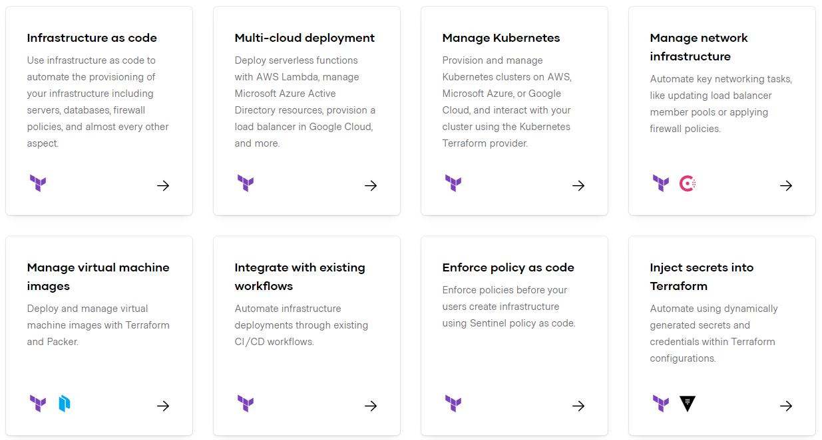
https://www.terraform.io/

Slide 14
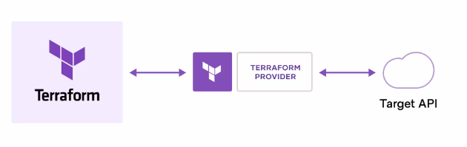
How does Terraform work?
Terraform creates and manages resources on cloud platforms and other services through their application programming interfaces (APIs). Providers enable Terraform to work with virtually any platform or service with an accessible API.
https://registry.terraform.io/

Slide 15
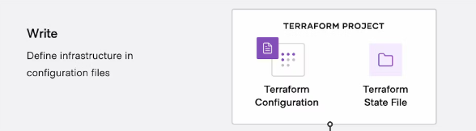
Terraform workflow stages: Write
You define resources, which may be across multiple cloud providers and services. For example, you might create a configuration to deploy an application on virtual machines in a Virtual Private Cloud (VPC) network with security groups and a load balancer.

Slide 16
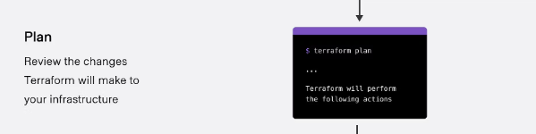
Terraform workflow stages: Plan
Terraform creates an execution plan describing the infrastructure it will create, update, or destroy based on the existing infrastructure and your configuration.

Slide 17
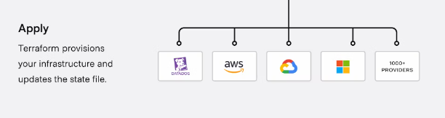
Terraform workflow stages: Apply
On approval, Terraform performs the proposed operations in the correct order, respecting any resource dependencies. For example, if you update the properties of a VPC and change the number of virtual machines in that VPC, Terraform will recreate the VPC before scaling the virtual machines.

Slide 18
Terraform HCL
HCL stands for HashiCorp Configuration Language. It is a domain-specific language (DSL) developed by HashiCorp, the company behind popular infrastructure-as-code tools like Terraform, Consul, Vault, and Packer.
HCL is used primarily for defining configurations and infrastructure in a human-readable and machine-friendly format.
HCL is designed to be easy to read and write and is used in various HashiCorp tools for defining configuration files. Some of the key features and characteristics of HCL include:
1. Declarative Syntax: HCL is a declarative language, which means you specify what you want your infrastructure to look like, and the underlying tools (e.g., Terraform) figure out how to make it happen.

Slide 19
Terraform HCL
2. Block Structure: HCL uses a block structure, with nested blocks and attributes, to define configurations. This helps maintain a clear and structured organization of configuration files.
3. Human-Readable: HCL is designed to be easily readable and writable by both humans and machines, which makes it accessible to infrastructure and DevOps engineers.
4. Variable Support: HCL supports variables, which can be used to parameterize your configuration and make it more flexible and reusable.

Slide 20
Terraform HCL
5. Interpolation: HCL allows for variable interpolation, where you can reference variables within other parts of your configuration.
6. Comments: HCL supports both single-line (`#`) and multi-line (`/* */`) comments, which are helpful for documentation and annotation.
7. Support for Multiple HashiCorp Tools: While HCL is most commonly associated with Terraform, it is also used in other HashiCorp tools like Consul, Nomad, Vault, and Packer, providing a consistent configuration language across the HashiCorp ecosystem.

Slide 21
Terraform with AWS
https://developer.hashicorp.com/terraform/tutorials/aws-get-started

Slide 22
HCL continues
count:
The count parameter is used to create multiple instances of a resource.
Interpolation:
Interpolation syntax ${} is used to dynamically generate unique bucket names like my-bucket-0, my-bucket-1, etc.
It’s also used in the tags to create unique names for each resource.

Slide 23
HCL continues
depends_on:
The depends_on meta-argument is used in the aws_iam_user_policy_attachment resource to ensure the IAM user is created before attaching the policy.
Parallel Execution:
Terraform inherently runs resources in parallel when possible. The S3 buckets in my_parallel_bucket are created independently of the my_bucket buckets, showcasing Terraform's parallel execution capabilities.

Slide 24
Terraform console
This command provides an interactive command-line console for evaluating and experimenting with expressions.
You can use it to test interpolations before using them in configurations and to interact with any values currently saved in state.
If the current state is empty or has not yet been created, you can use the console to experiment with the expression syntax and built-in functions.
The console holds a lock on the state, and you will not be able to use the console while performing other actions that modify state.
To close the console, enter the exit command or press Control-C or Control-D.
$ terraform console

Slide 25
Expressions
Expressions refer to or compute values within a configuration. The simplest expressions are just literal values, like "hello" or 5, but the Terraform language also allows more complex expressions such as references to data exported by resources, arithmetic, conditional evaluation, and a number of built-in functions.
https://developer.hashicorp.com/terraform/language/expressions

Slide 26
Functions
The Terraform language includes a number of built-in functions that you can call from within expressions to transform and combine values. The general syntax for function calls is a function name followed by comma-separated arguments in parentheses:
max(5, 12, 9)
https://developer.hashicorp.com/terraform/language/functions

Slide 27
Locals
A local value assigns a name to an expression, so you can use the name multiple times within a module instead of repeating the expression.
If you're familiar with traditional programming languages, it can be useful to compare Terraform modules to function definitions:
Input variables are like function arguments.
Output values are like function return values.
Local values are like a function's temporary local variables.

Slide 28
Locals
locals {
service_name = "forum"
owner = "Community Team"
}

Slide 29
Locals
locals {
# Ids for multiple sets of EC2 instances, merged together
instance_ids = concat(aws_instance.blue.*.id, aws_instance.green.*.id)
}
locals {
# Common tags to be assigned to all resources
common_tags = {
Service = local.service_name
Owner = local.owner
}
}

Slide 30
Data Sources
Data sources allow Terraform to use information defined outside of Terraform, defined by another separate Terraform configuration, or modified by functions.
data "aws_ami" "example" {
most_recent = true
owners = ["self"]
tags = {
Name = "app-server"
Tested = "true"
}
}

Slide 31
dynamic Blocks
Within top-level block constructs like resources, expressions can usually be used only when assigning a value to an argument using the name = expression form. This covers many uses, but some resource types include repeatable nested blocks in their arguments, which typically represent separate objects that are related to (or embedded within) the containing object:

Slide 32
dynamic Blocks
resource "aws_elastic_beanstalk_environment" "tfenvtest" {
name = "tf-test-name" # can use expressions here
setting {
# but the "setting" block is always a literal block
}
}

Slide 33
dynamic Blocks
resource "aws_elastic_beanstalk_environment" "tfenvtest" {
name = "tf-test-name"
application = "${aws_elastic_beanstalk_application.tftest.name}"
solution_stack_name = "64bit Amazon Linux 2018.03 v2.11.4 running Go 1.12.6"
dynamic "setting" {
for_each = var.settings
content {
namespace = setting.value["namespace"]
name = setting.value["name"]
value = setting.value["value"]
}
}
}

Slide 34
Modules
Modules are containers for multiple resources that are used together. A module consists of a collection of .tf and/or .tf.json files kept together in a directory.
Modules are the main way to package and reuse resource configurations with Terraform.
The Root Module
Every Terraform configuration has at least one module, known as its root module, which consists of the resources defined in the .tf files in the main working directory.

Slide 35
Modules
Child Modules
A Terraform module (usually the root module of a configuration) can call other modules to include their resources into the configuration. A module that has been called by another module is often referred to as a child module.

Slide 36
Modules
Published Modules
In addition to modules from the local filesystem, Terraform can load modules from a public or private registry. This makes it possible to publish modules for others to use, and to use modules that others have published.
The Terraform Registry hosts a broad collection of publicly available Terraform modules for configuring many kinds of common infrastructure.

